Slide 1

AIP491
Applied AI for Agriculture – Fruit Quality Assessment for Harvesting Automatic
Mentor : Trương Hoàng Vinh

Slide 2
MEMBER
Huỳnh Lê Trung Minh
Trần Minh Huy
Phan Đức Hiền
Nguyễn Cang Trường
Trần Quốc Lợi
SE150305
SE150803
SE173074
SE160466
SE171814

Slide 3

Overview
Introduction
1
Related work
2
Models
3
Data , Data Processing
4
Results
5
Deploy
6

Slide 4


INTRODUCTION

Slide 5
1.1 Problem
Nowadays, the agricultural and food industry is developing, but we lack human resources, so our group decided to use computer vision to solve the human resource problem.
Establishing a computer vision system capable of detecting and identifying fruit quality fit for use on robotic tools for automated harvesting is the major aim of this research.

Slide 6
1.2 Scope of the project
Tomatoes and strawberries detection in various stage (ripe, half-ripe, unripe)
Make custom dataset, balance classes in the dataset
Experiment on YOLO versions (v5, v7, v8, v9, v10, v11)

Slide 7
RELATED WORKS

Slide 8
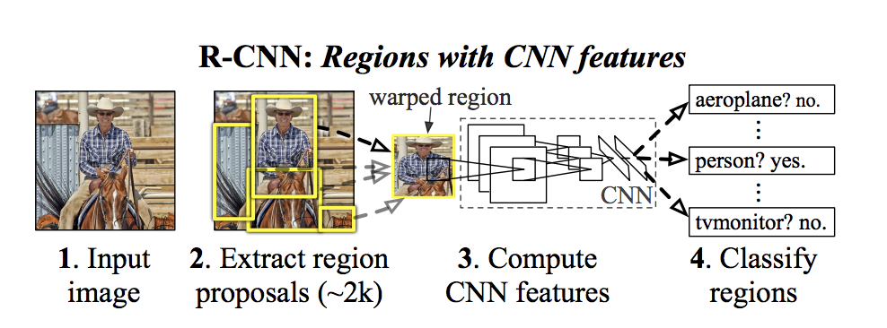
R-CNN
Foundational model that use region proposals to detect objects within images
Applies a CNN to each proposed region to classify objects and refine bounding boxes
Due to its computational intensity and slower processing time, less commonly used in real-time applications, more suited for scenarios requiring high accuracy over speed

Slide 9
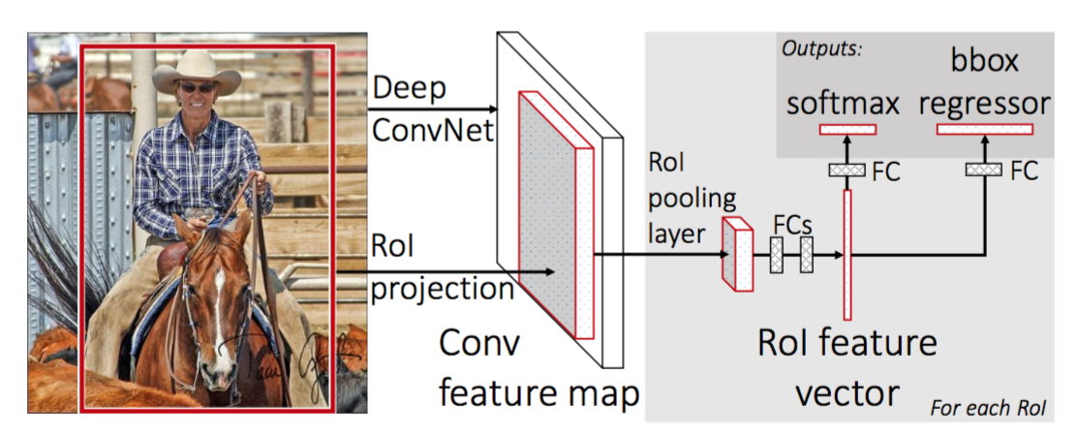
Fast R-CNN
Integrates region proposals and classification into a single network
Reducing computation time
Delivers accurate fruit detection results, but its reliance on external region proposal algorithms, like Selective Search, can limit its speed and scalability compared to more advanced methods

Slide 10
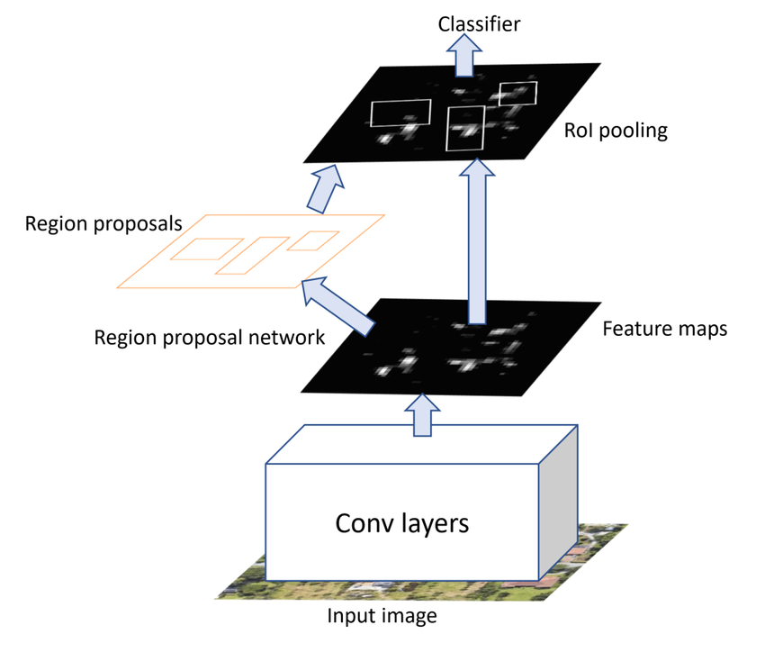
Faster R-CNN
Integrates a Region Proposal Network (RPN), which streamlines the generation of region proposals
Make it faster and more efficient than its predecessors while maintaining high accuracy
Particularly effective in detecting fruits in complex environments and has been adapted with fine-tuned backbones and anchor box adjustments to further enhance its performance
Still slower than real-time detection models like YOLO

Slide 11
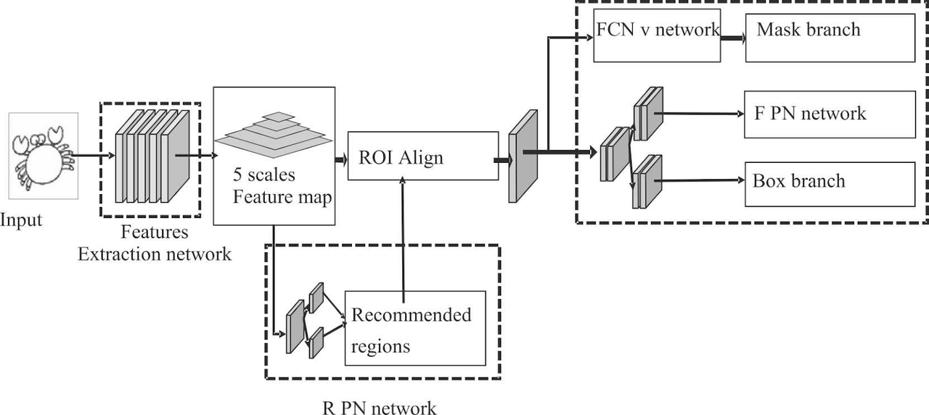
Mask R-CNN
Able to perform object detection and instance segmentation simultaneously
Provides precise localization and segmentation of fruits, making it ideal for complex environments
Researchers often optimize it with tailored backbones and anchor box adjustments to achieve high accuracy in identifying and segmenting fruit
Its computational demands limit its use in real-time applications

Slide 12
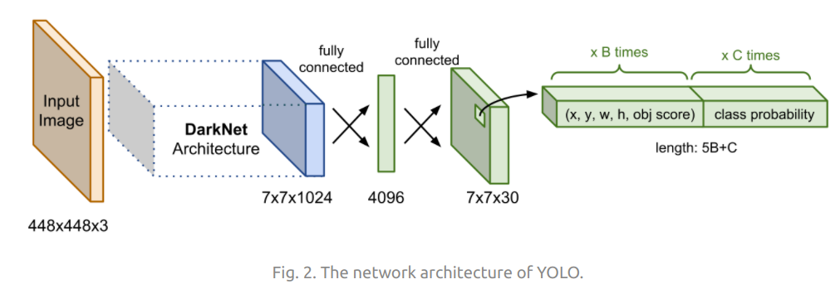
YOLO
Widely used in fruit detection for its real-time speed and accuracy
Processes entire image in a single pass, making it efficient for detecting fruits in various environments
Have been applied to tasks like mango and apple detection, achieving high precision and F1 score
Ideal for practical, real-time applications relating to fruit detection

Slide 13
COMPARE MODELS ON MS-COCO DATASET
Methods | Parameters | mAP50-95 | Inference speed | Training Time
Fast R-CNN (ResNet-50 FPN, 1x) | 41 millions | 19.7% | 0.029 seconds/image | 4 hours
Faster R-CNN (ResNet-101 FPN, 3x) | 61 millions | 21.9% | 0.051 seconds/image | 21 hours
Mask R-CNN(ResNet-101 FPN, 3x) | 63 millions | 39.4% | 0.056 seconds/image | 1.06 days
YOLO (YOLOv11n) | 2.6 millions | 39.5% | 0.0015 seconds/image | 3 - 5 hours

Slide 14
MODELS

Slide 15
Architectures of YOLO versions that we used
We have tested our custom dataset on various versions of YOLO, particularly YOLOv5, YOLOv7, YOLOv8, YOLOv9, YOLOv10 and YOLOv11

Slide 16
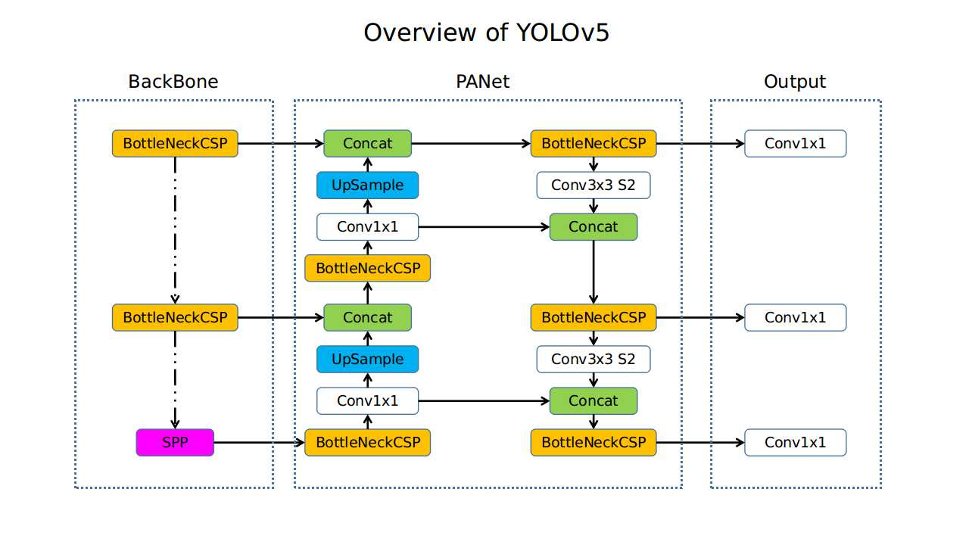
YOLOv5

Slide 17
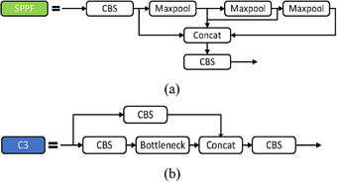
YOLOv5 - Advancements
SPPF (Spatial Pyramid Pooling - Fast)
Pooling with different kernel sizes ensures that features from both small and large receptive fields are captured.
By stacking three max-pooling operations instead of using the original SPP's more complex pyramid design, the SPPF layer reduces computational complexity.
Compact design, lightweight

Slide 18
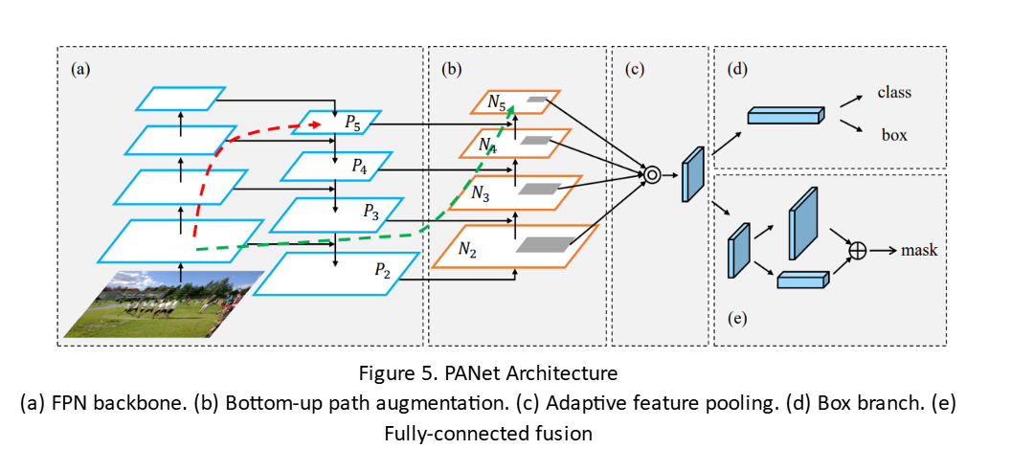
YOLOv5 - Advancements
PANet Architecture
Bridges the gap between high-level semantic features and low-level spatial details:
FPN-like Top-Down Pathway: Combines high-level semantic information with lower-level spatial features using upsampling. Facilitates the propagation of semantic context across layers, aiding in object detection at different scales.
Bottom-Up Pathway: Introduces a reversed flow of information from lower layers back to higher layers. Ensures better feature localization by preserving spatial information while enriching it with high-level context.
Adaptive Feature Pooling: Dynamically selects features from multiple scales, helping the model adapt to diverse object sizes.

Slide 19
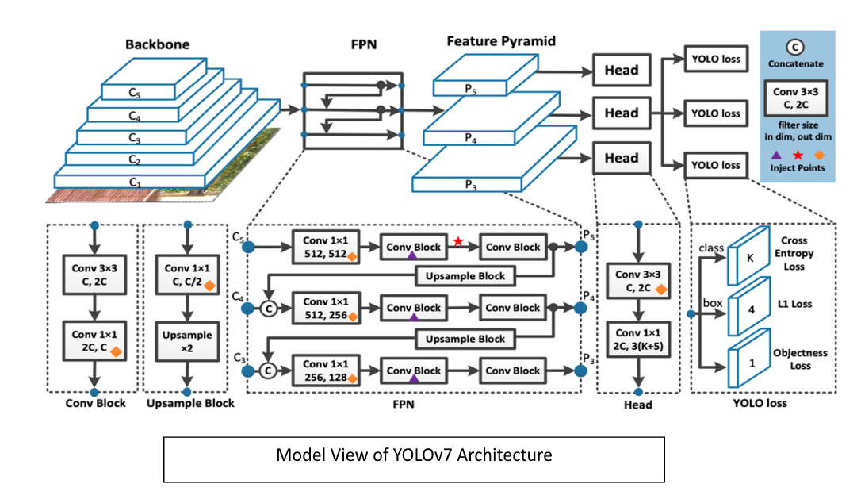
YOLOv7

Slide 20
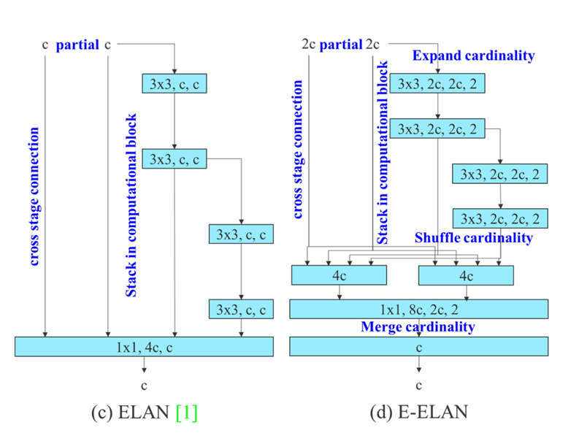
YOLOv7 - Advancements
E-ELAN
In addition to maintaining the original ELAN design architecture, E-ELAN can also guide different groups of computational blocks to learn more diverse features.
Nội dung đoạn văn bản của bạn

Slide 21
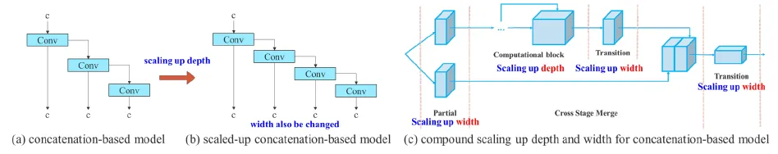
YOLOv7 - Advancements
Model Scaling for Concatenation-Based Models
From (a) to (b): It is observed that when depth scaling is performed on concatenation-based models, the output width of a computational block also increases. This phenomenon will cause the input width of the subsequent transmission layer to increase.
(c) Proposed Model Scaling: When performing model scaling on concatenation-based models, only the depth in a computational block needs to be scaled, and the remaining of transmission layer is performed with corresponding width scaling.
The proposed compound scaling method can maintain the properties that the model had at the initial design and maintains the optimal structure.

Slide 22
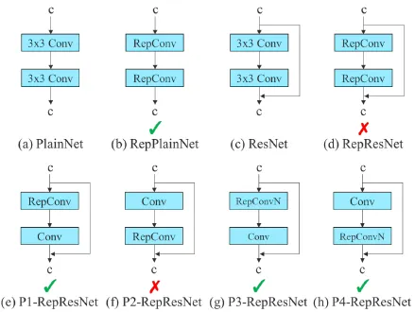
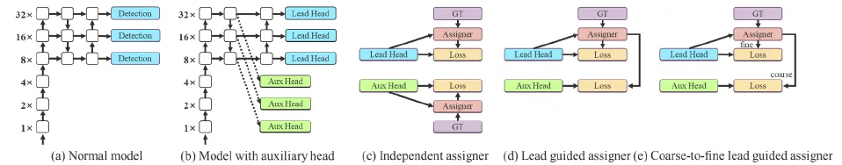
YOLOv7 - Advancements
Trainable Bag-of-Freebies
Re-Parameterized Convolution
Coarse for Auxiliary and Fine for Lead Loss
Coarse-to-Fine Lead Head Guided Label Assigner: Similar to (d), however, two different sets of soft label are generated, i.e., coarse label and fine label.
RepConv actually combines 3×3 convolution, 1×1 convolution, and identity connection in one convolutional layer.
Proposed: RepConv without identity connection (RepConvN) is used to design the architecture of planned re-parameterized convolution.

Slide 23
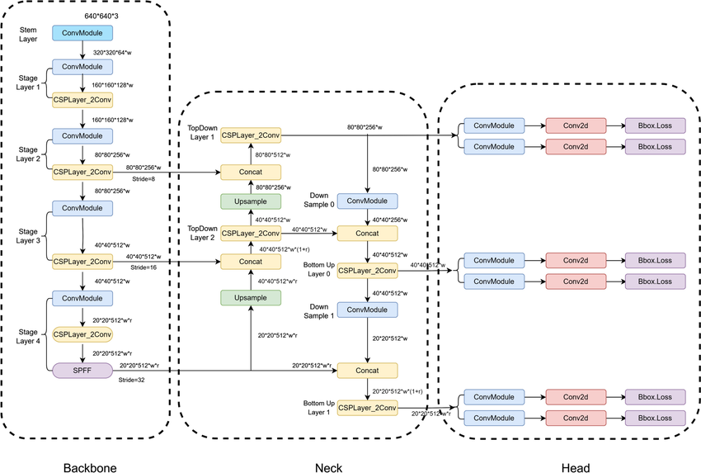
YOLOv8

Slide 24
YOLOv8 - Advancements
CSP Improvements
Lighter and Faster Backbone
Uses an optimized version of Cross-Stage Partial Networks (CSP) for efficient feature extraction. Enhancements include:
Better gradient flow through improved residual connections.
Reduced memory usage and computational cost.
Enhanced feature reuse for better representation learning.
YOLOv8 features a lighter backbone optimized for real-time performance on edge devices.
Supports scalable architecture to adjust model size (Nano, Small, Medium, Large, X-Large) to balance accuracy and speed.

Slide 25
YOLOv8 - Advancements
Path Aggregation Network (PANet)
Enhanced Feature Pyramid (EFP)
Refined PANet for efficient multi-scale feature fusion:
Combines high-resolution spatial information with low-resolution semantic features.
Improved small-object detection.
Incorporates better feature pyramid mechanisms to aggregate features from multiple scales.
Leads to robust detection of objects at various sizes and distances.

Slide 26
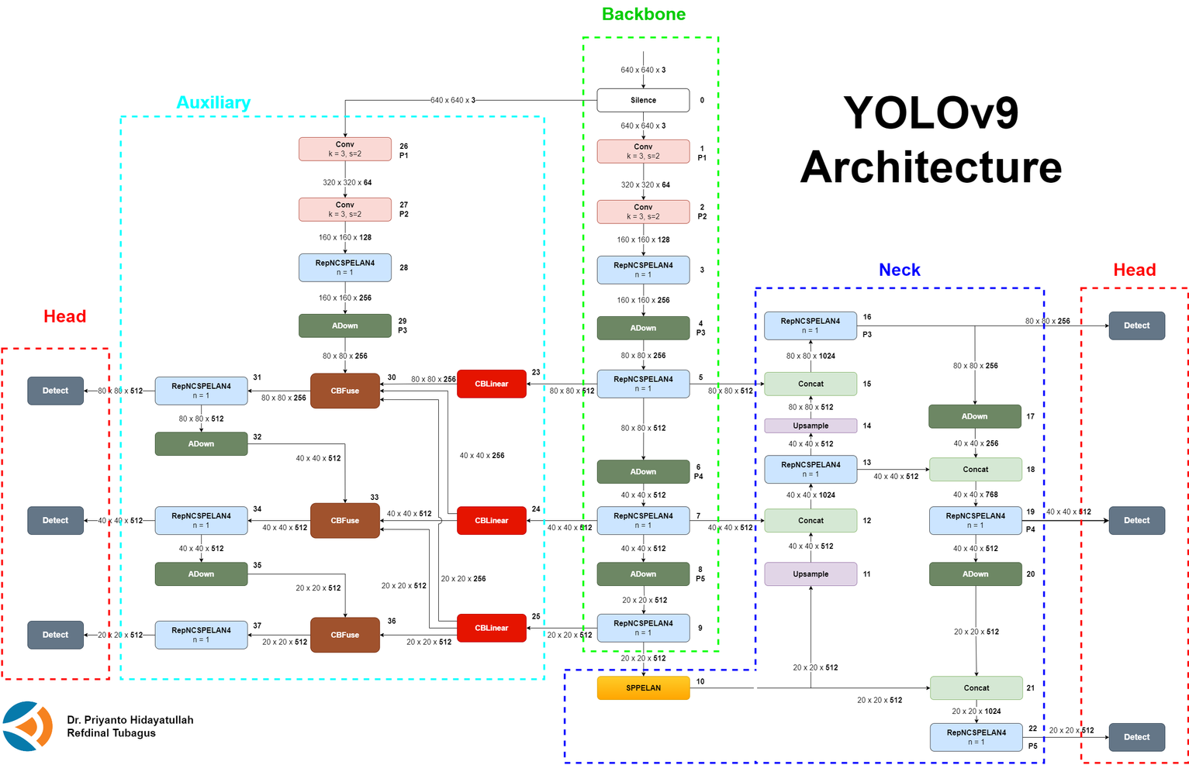
YOLOv9

Slide 27
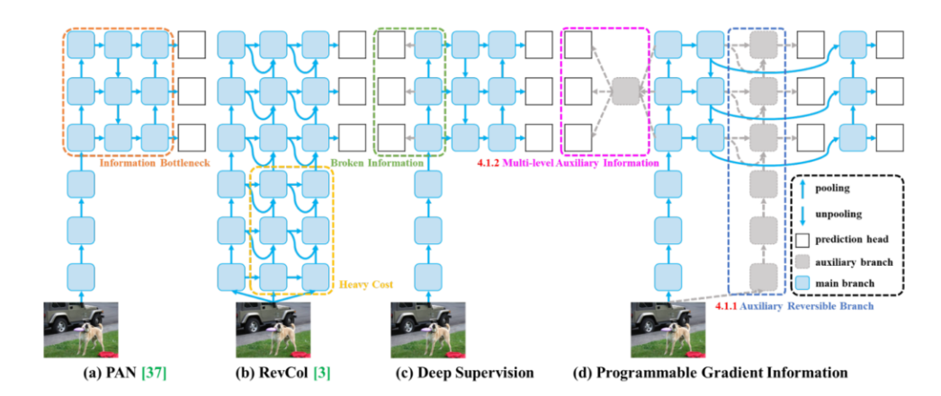
YOLOv9 - Advancements
Programmable Gradient Information (PGI)
This technique introduces auxiliary reversible branches within the model to improve gradient propagation, enhancing the model's training efficiency.
PGI helps reduce information loss at each layers, as it preserves more information for improved accuracy

Slide 28
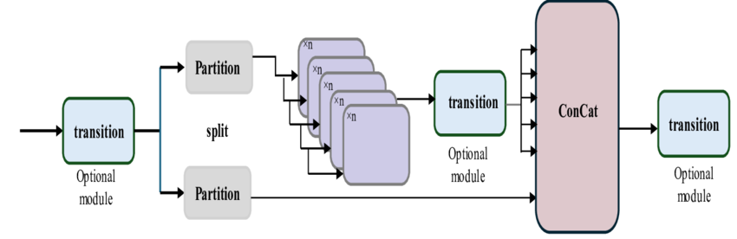
YOLOv9 - Advancements
Generalized Efficient Layer Aggregation Network (GELAN):
GELAN integrates concepts from CSPNet and ELAN to optimize the architecture for efficient feature aggregation and gradient propagation.
It combines the best of both worlds, improving both speed and accuracy without sacrificing performance​.

Slide 29
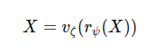
YOLOv9 - Advancements
Reversible Function
r : Foward transformation
v : Reverse transformation
ψ: Parameters of forward transformation
ζ: Parameters of reverse transformation
The use of reversible functions allows YOLOv9 to eliminate information bottlenecks by ensuring that data transformations in the network are lossless. This results in more stable gradients and better convergence during training

Slide 30
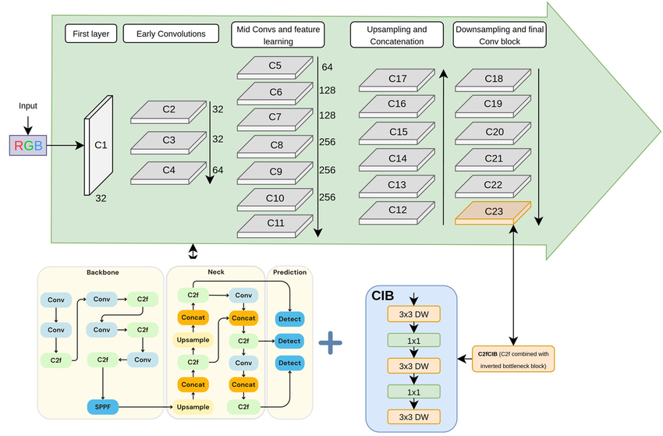
YOLOv10

Slide 31
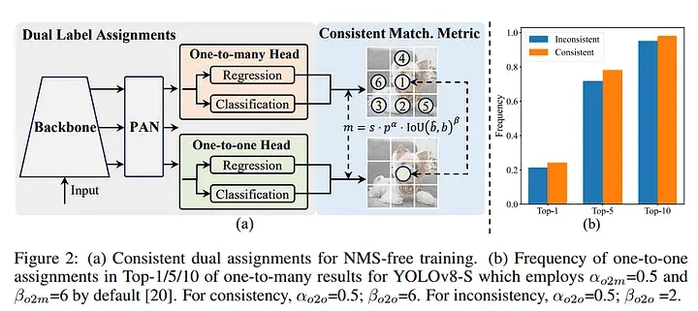
YOLOv10 - Advancements
NMS-Free Training
YOLOv10 eliminates the need for Non-Maximum Suppression (NMS) during inference by employing consistent dual assignments.
Streamlining the detection process and reducing latency

Slide 32
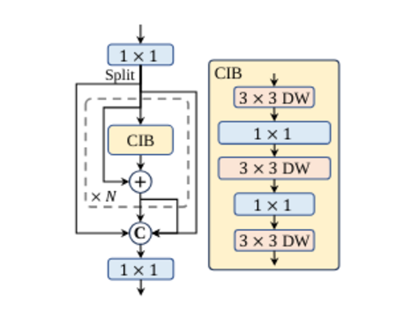
YOLOv10 - Advancements
Rank-Guided Block Design
Introduces a compact inverted block (CIB) structure, informed by rank analysis to optimize redundancy in deeper layers
Spatial-Channel Decoupled Downsampling
Applies pointwise convolution for channel modification, then depthwise convolution for spatial downsampling, significantly reducing computational costs and preserving information
Lightweight Classification Head
Convolutions (3×3) followed by a 1×1 convolution

Slide 33
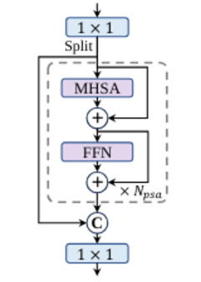
YOLOv10 - Advancements
Large-Kernel Convolution
YOLOv10 employs large-kernel depthwise convolutions selectively in deeper stages, enhancing the receptive field without compromising shallow feature detection or increasing latency significantly
Partial Self-Attention (PSA)
Processes only one segment of features through efficient NPSA blocks, followed by concatenation

Slide 34
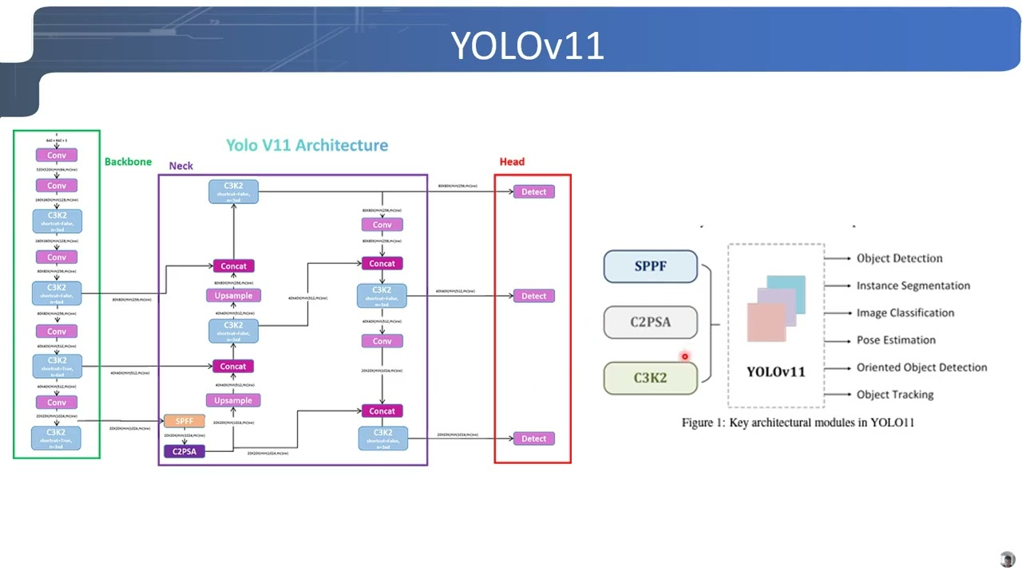
YOLOv11

Slide 35
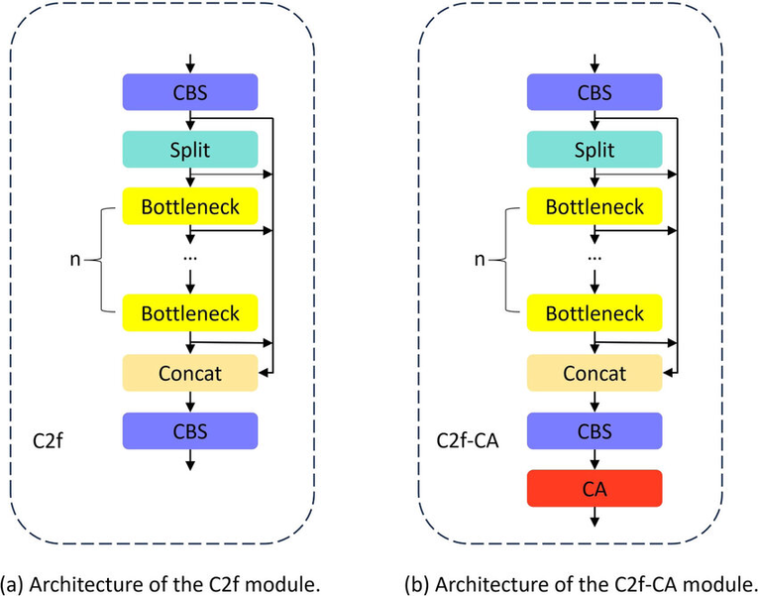
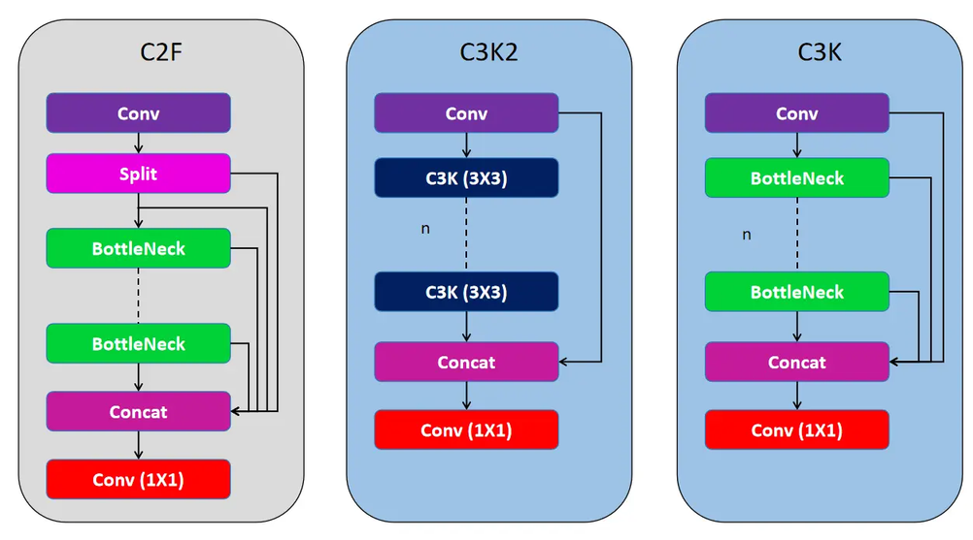
YOLOv11 - Advancements
C2F
The C2F block (Cross Stage Partial Focus)
enhances efficiency and feature map preservation. It starts with a Conv Block
C3K2
For feature extraction, employing smaller 3x3 kernels
for efficient computation while capturing essential image features

Slide 36
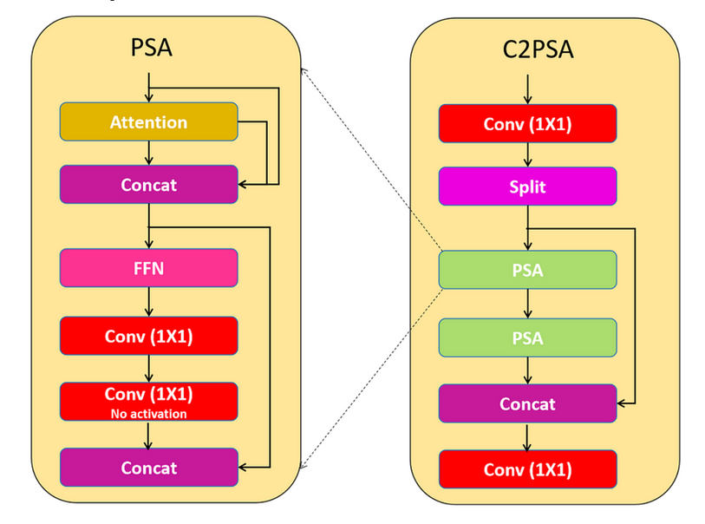
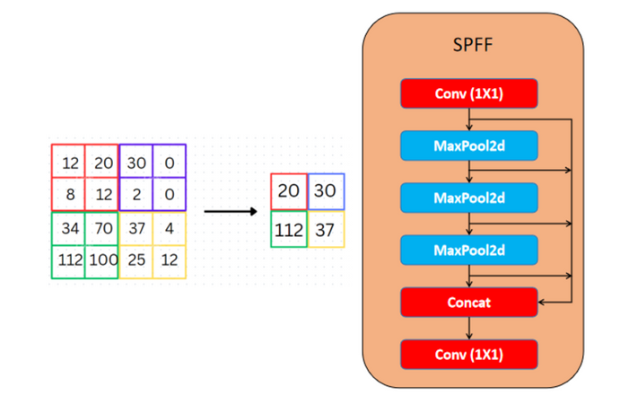
YOLOv11 - Advancements
Spatial Pyramid Pooling Fast (SPFF) and Upsampling
Attention Mechanisms: C2PSA Block
C2PSA
Position-Sensitive Attention
It processes input through an Attention layer, concatenates it with the output, and passes it through a Feed Forward Neural Network, followed by two Conv Blocks
The SPFF module uses multiple max-pooling operations with different kernel sizes to aggregate contextual information, allowing for effective detection of small objects while maintaining real-time processing speeds

Slide 37
YOLOv11 - Advancements
Detection and Multi-Scale Predictions
YOLOv11 has a multi-scale prediction head that detects objects of various sizes. It generates detection boxes for three scales (low, medium, high) based on feature maps from the backbone and neck components.
The detection head provides predictions from three feature maps (P3, P4, and P5), ensuring precise detection of smaller objects (P3) and larger objects represented by higher-level features (P5).

Slide 38
Compare YOLOv11 and other YOLO versions
About Backbone
YOLOv11: Using efficient Hybrid Backbone combines Transformer blocks and Convolutional Neural Networks to optimize the ability to detect small details (like patterns on fruit or signs of disease).
Transformer blocks: Helps identify global spatial relationships, very useful when distinguishing between classes with small differences.
Enhanced CNN Layers: Optimize the ability to capture local features (such as shape, texture).
YOLOv5-v10: Uses basic backbones such as CSPDarknet (YOLOv5) and improved CSPNet (YOLOv8-v10). Although good, it lacks the ability to recognize features related to global space.

Slide 39
Compare YOLOv11 and other YOLO versions
About Neck
YOLOv11: Apply Dynamic Path Aggregation (DPA), which helps combine information from multiple levels (low-level and high-level) more intelligently.
DPA helps distinguish well between fruits at different stages of ripeness or when fruits are partially obscured.
Integrate additional Attention Mechanisms to focus on areas containing important information (such as parts being rotten or melasma).
YOLOv7-v10: Uses Path Aggregation Network (PANet) or simpler variants, which may be limited in combining complex information.

Slide 40
Compare YOLOv11 and other YOLO versions
About Head
YOLOv11: Supports Adaptive Anchor-Free Prediction, without relying on anchor boxes, helping to more accurately identify objects that are not uniform in size (like large cherries and tomatoes in the same image).
Use Bi-directional Feature Pyramid Network (BiFPN) to improve prediction of small objects (like unripe fruit or very small signs of disease).
YOLOv5-v10: Heavily dependent on static (YOLOv5, YOLOv7) or semi-adaptive (YOLOv8-v10) anchor boxes, so less flexible with heterogeneous data.

Slide 41
DATA

Slide 42
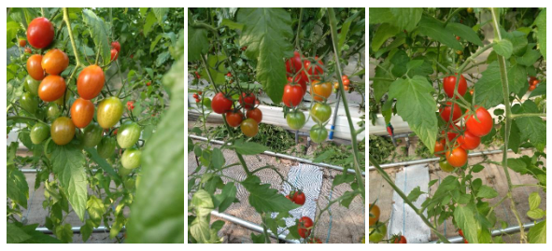
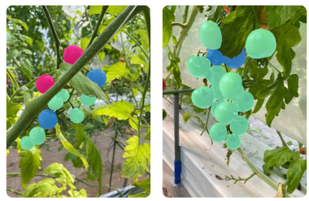
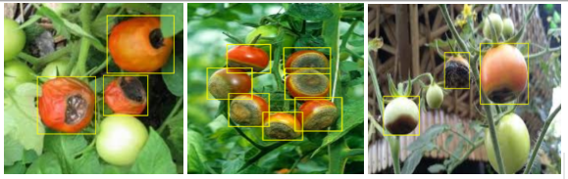
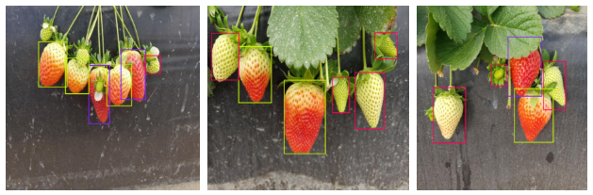
Data Preparation
LaboroTomato
804 images with 10610 labeled objects belonging to 6 different classes including:
b_green, l_green.
b_fully_ripened, l_fully_ripened.
b_half_ripened, l_half_ripened.
Tomato blossom end rot
The dataset has a total of 491 images and 940 annotations.
Tomato Blossom end rot
Strawberry
2756 images with 7.311 labeled objects include 3 classes:
Strawberry ripe.
Strawberry unripe.
Strawberry half ripe.

Slide 43
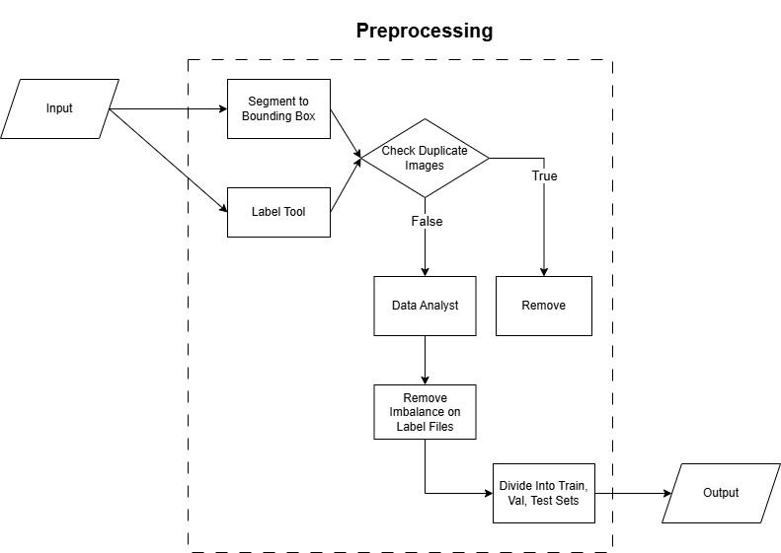
Data Preprocessing

Slide 44
Data Preprocessing
Transform segmentation labels into bounding box labels
Label Tool
Remove duplicate images
Balance classes of the data
Divide the dataset into train, validation, test sets according to the ratio of 8:1:1

Slide 45
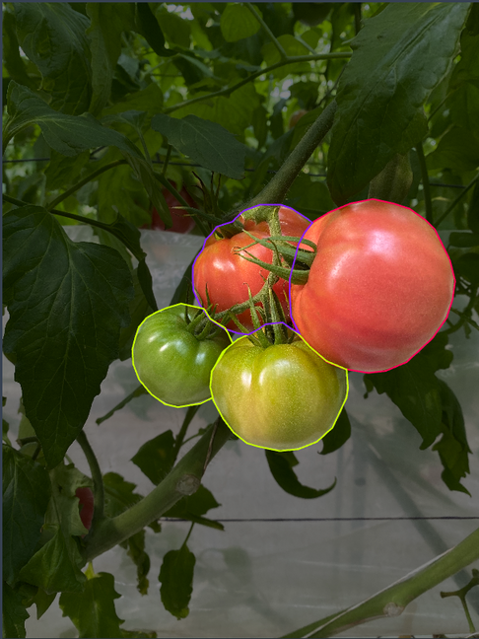
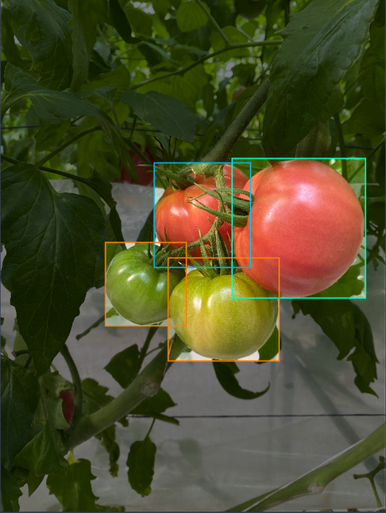
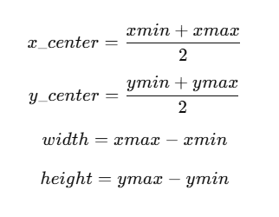
Data Preprocessing
Transform segmentation labels into bounding box labels

Slide 46
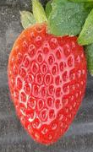
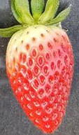
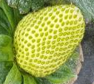
Data Preprocessing
Label Tool
Red color on 90% or more
Red color on 30-89%
Red color on 0-30%

Slide 47
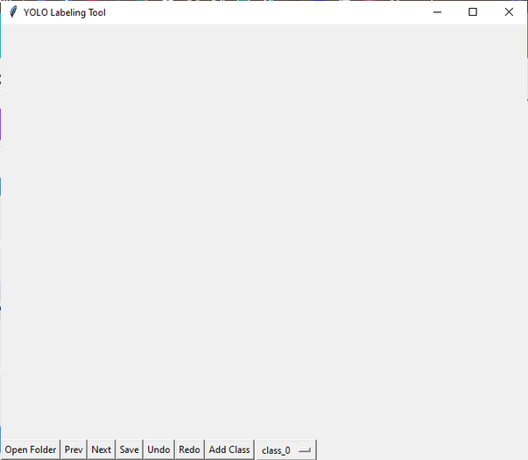
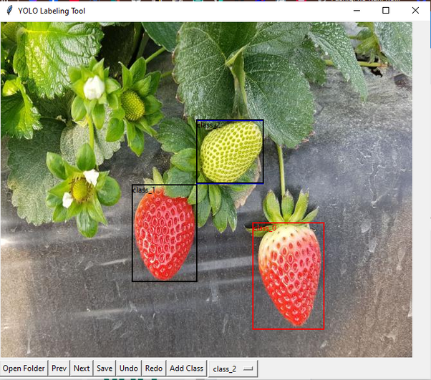
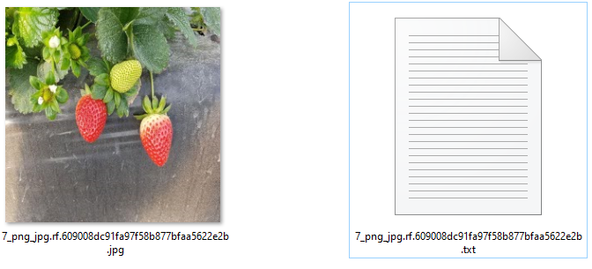
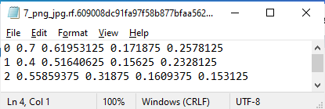
Data Preprocessing
Label Tool
Label tool
Class label
Images and labels

Slide 48
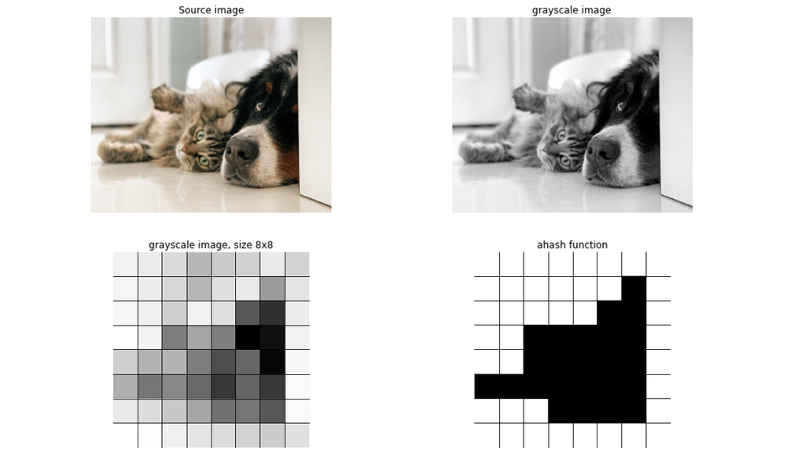
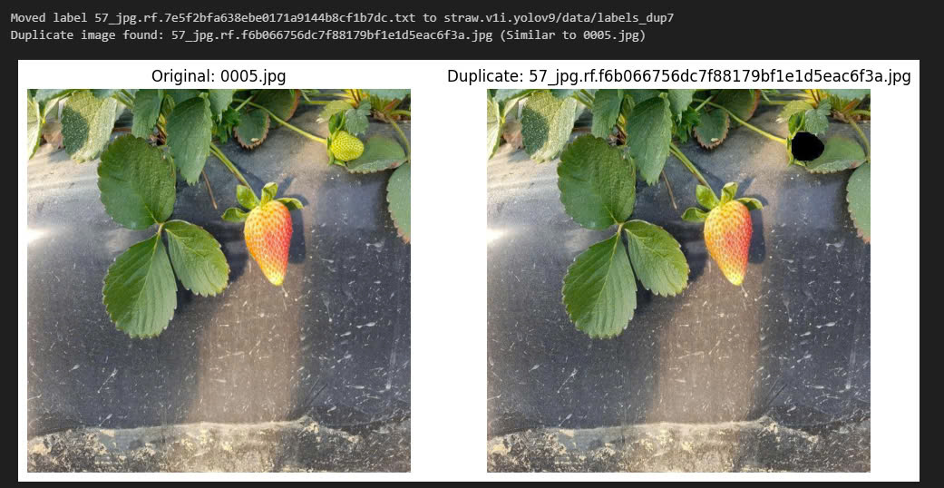
Data Preprocessing
Remove duplicate images
Average Hashing (aHash)
Check duplicate images

Slide 49
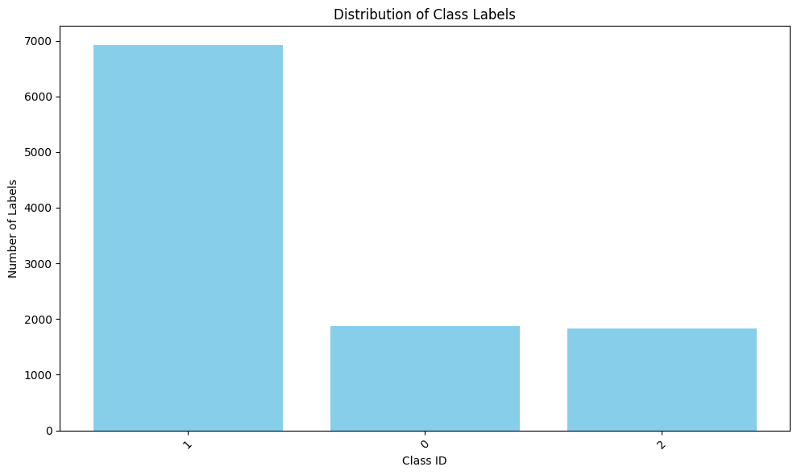
Data Preprocessing
Balance classes of the data
Statistics of the number of each class (sorted by class name):
Class 0: 1870 labels
Class 1: 6917 labels
Class 2: 1823 labels
|(class1 - class0) + (class1 - class 2) + (class0 - class2)|

Slide 50
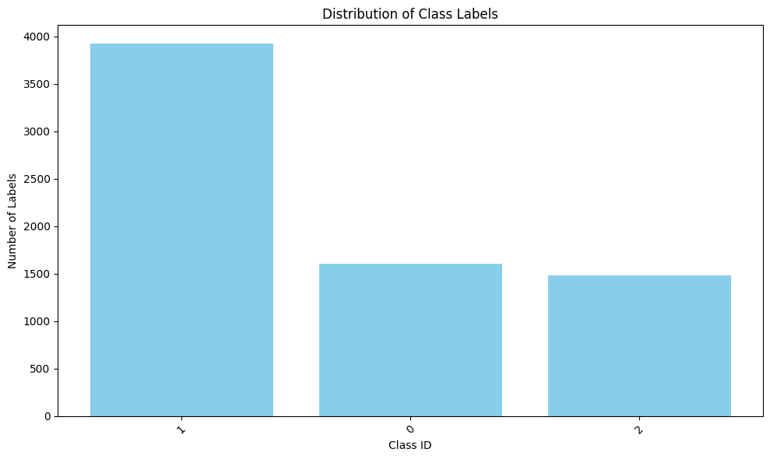
Data Preprocessing
Balance classes of the data
Class 0: 2335 labels
Class 1: 1935 labels
Class 2: 2730 labels
Total labels: 7000

Slide 51
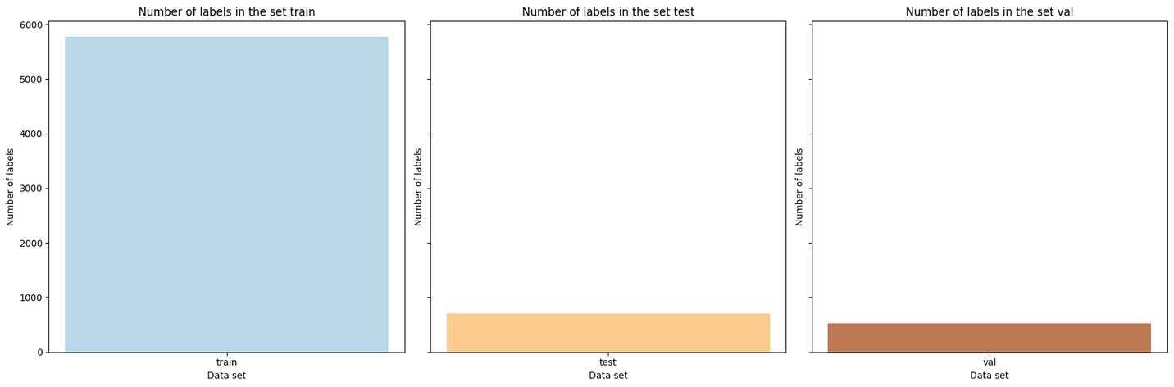
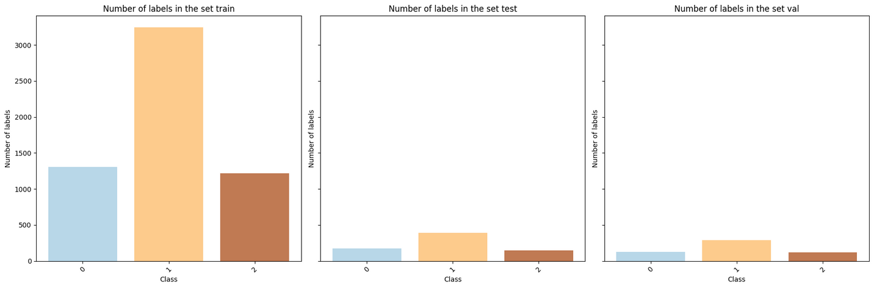
Data Preprocessing
Divide the dataset into train, validation, test sets according to the ratio of 8:1:1
Sum of labels in train, test, val set
Number of individual labels in train, test, val set

Slide 52
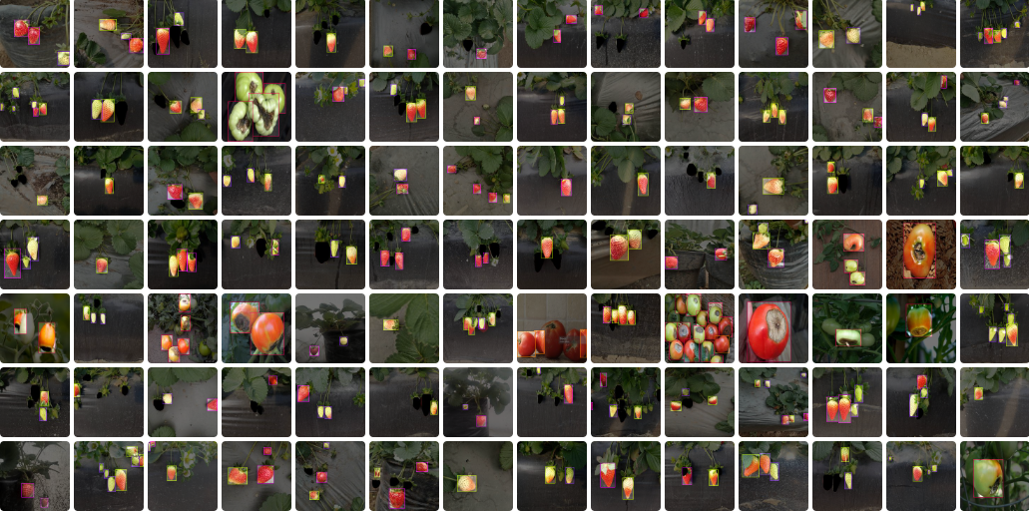
Dataset
Number of Images: 3,397
Number of Annotations: 14657
tomato_unripe: 4596
tomato_ripe: 1361
tomato_half_ripe: 1020
straw_unripe: 2730
straw_half_ripe: 2404
straw_ripe: 1967
tomato_Blossom_end_rot: 579

Slide 53
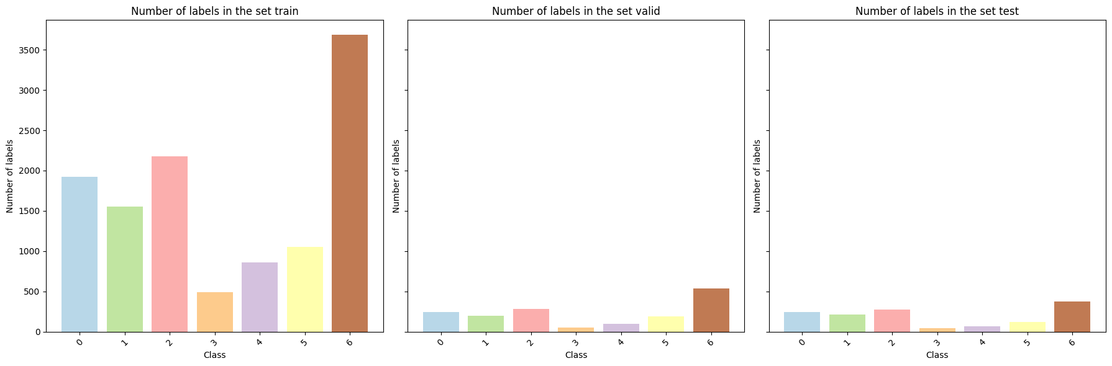
Final dataset

Slide 54
Parameters
Learning rate : 0,001
Batch size : 32
Epochs : 100
Patience : 5
Optimizer : adamw
GPU : P100 on Kaggle

Slide 55
RESULTS

Slide 56

Statistics
According to the comparison, we see that the results yolo tiny (5,8,11) have fewer parameters but the results and accuracy are the highest in our custom dataset

Slide 57

The first will be the YOLOv5nu model
We can see that the model identifies the object as 100% ripe tomato, and the boxes are very accurately surrounding the tomato

Slide 58

The second will be model YOLOv8n
We can see that the model identifies more objects, identifies more distant objects but identifies the wrong object, while there is no tomato blossom end rot, and identifies error boxes and duplicate boxeso

Slide 59

Finally YOLOv11n
We can see that this is the model that gives the best results compared to the previous two models. The model can identify far and near objects, not misidentify objects, and correctly identify nearly ripe tomatoes, so this is the model that gives the most accurate and most stable practical running results

Slide 60


Slide 61


Slide 62

THANK YOU!

